Slide 1






Keep it clean: The air we breathe
Save Carbon County
Air Quality Presentation
www.savecarboncounty.com

Slide 2
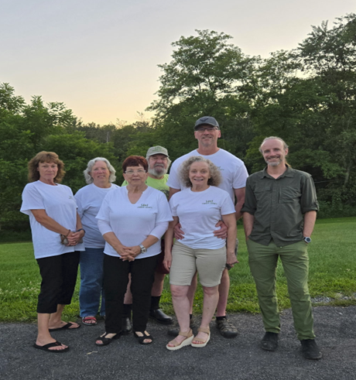
What do you love about where you live?
What do you love about Carbon County?
We are dedicated to saving what we love about Carbon County - our trees, rivers, creeks, and rural charm. Our goal is to bring people and ideas together to advocate for Community needs, clean air, water, and soil.
Here is a picture of our Officers and Steering Committee.
www.savecarboncounty.com

Slide 3


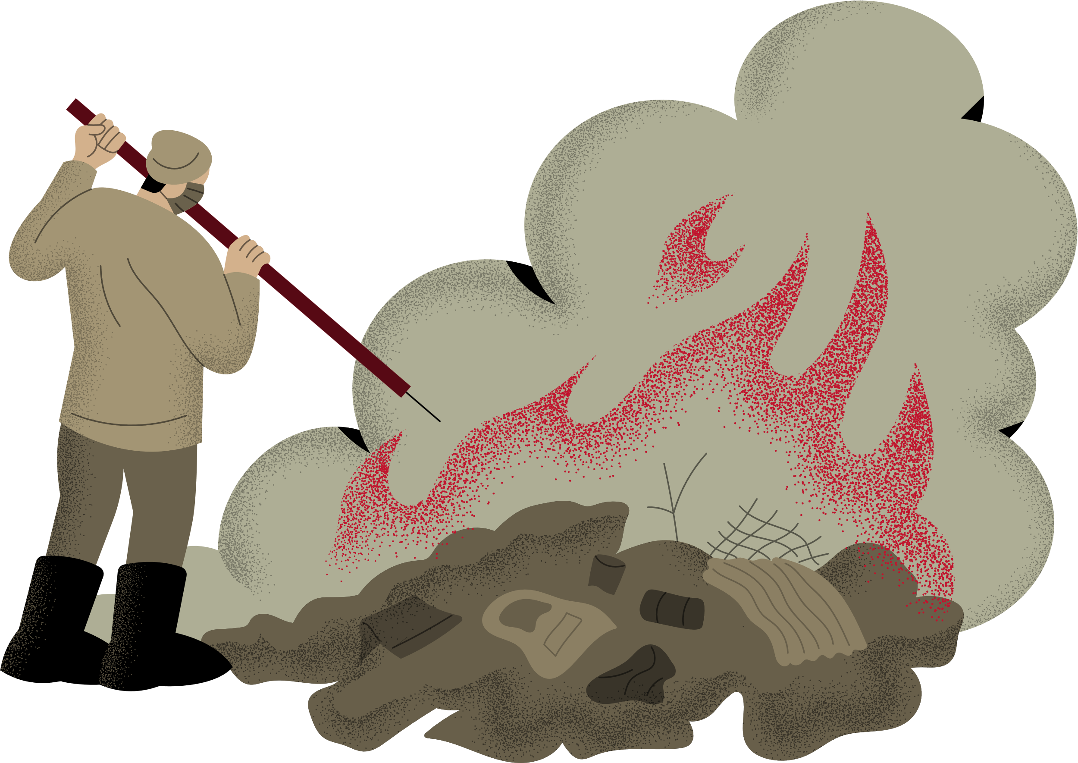

What is Air Pollution?
Air pollution means that the air is not clean anymore. Sometimes, tiny things like smoke, dust, or harmful gases float around in the air, even if we can’t always see them. These things can come from cars, factories, fires, or even natural events like forest fires. When the air is polluted, it can make it harder for people, animals, and plants to stay healthy.

Slide 4


What Causes Air Pollution?
There are many things that make the air dirty. Some of them are made by people, and others come from nature.
Natural causes like volcanoes and wildfires
Smoke from cars and
trucks
Gas and dust from factories
Burning trash or firewood

Slide 5



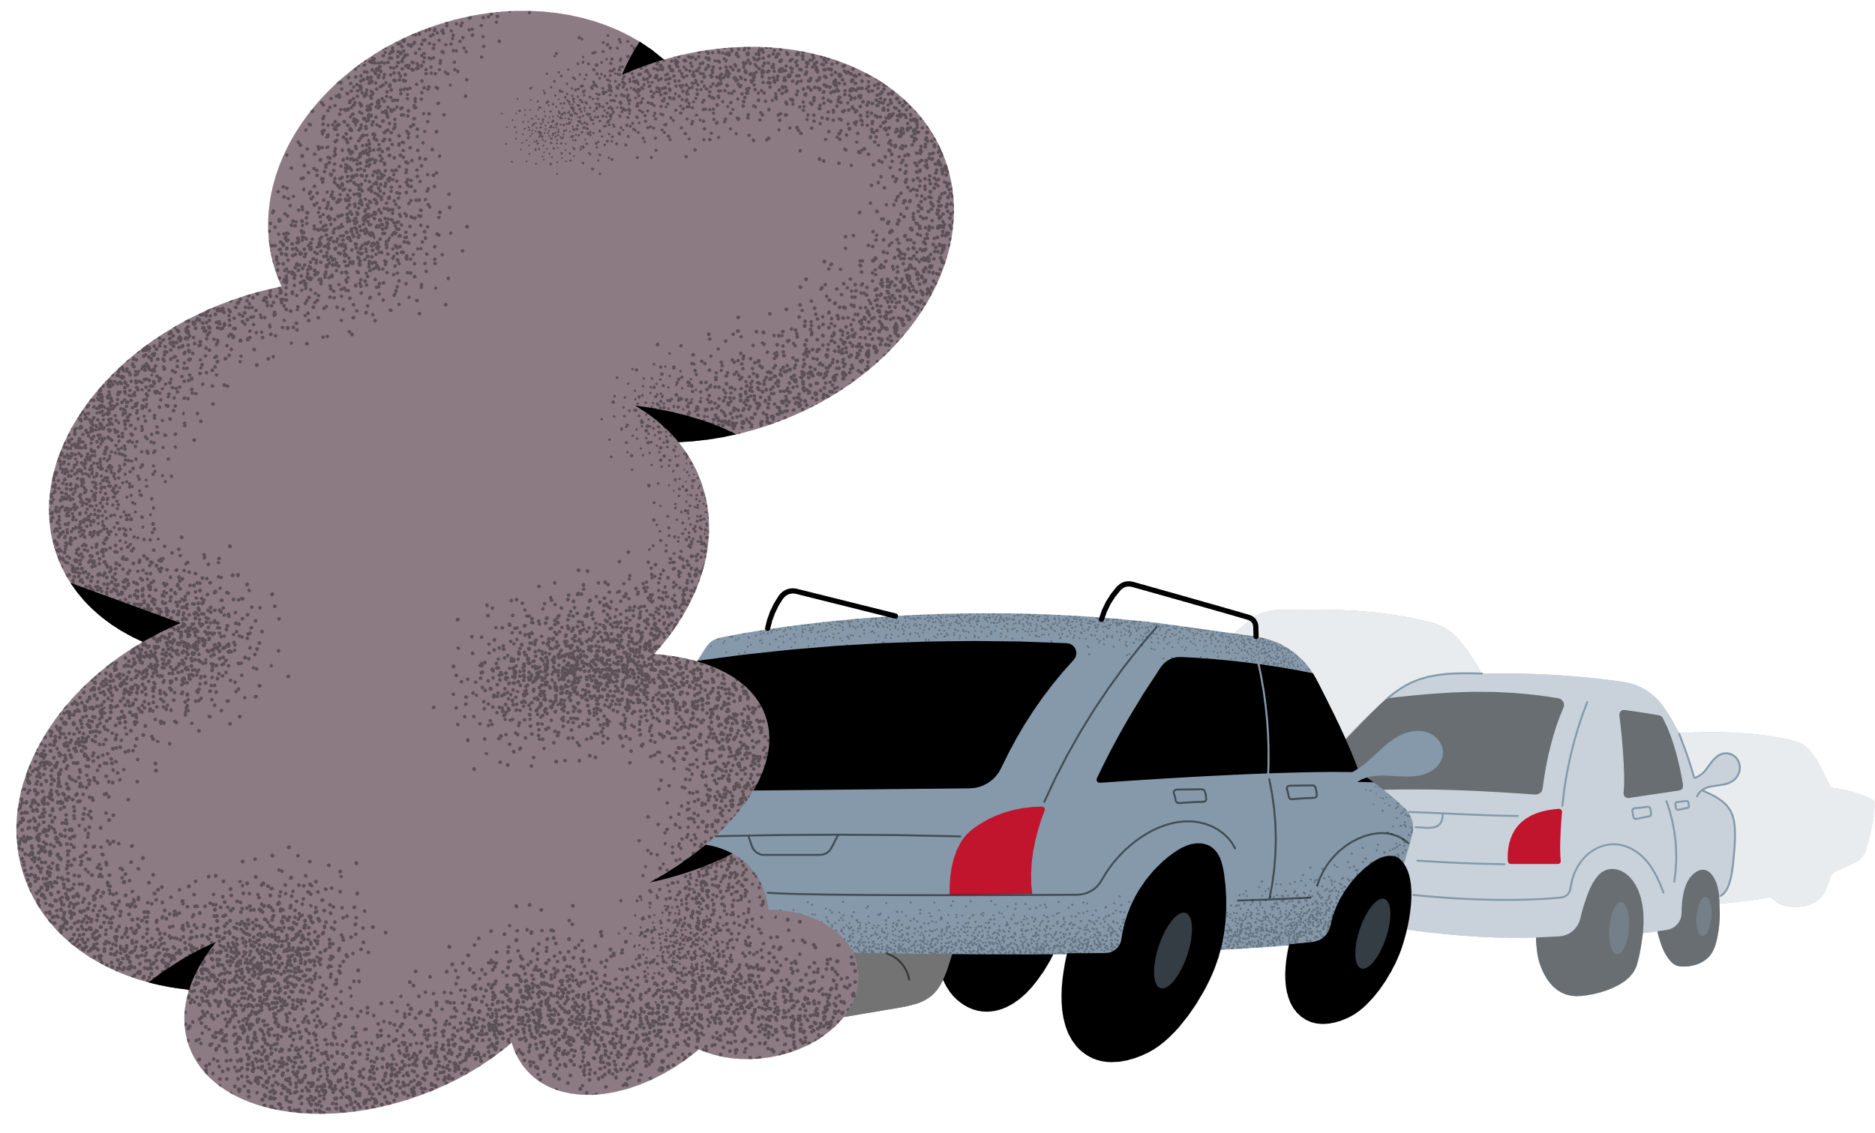

Why Do We Need Clean Air?
Clean air helps us feel good and stay healthy.
When we breathe fresh air, our lungs work better and our bodies can move and grow the way they should.
For children, clean air helps them play, run, and learn better.
Even animals and trees need fresh air to live. That’s why clean air is so important for everyone on Earth.

Slide 6
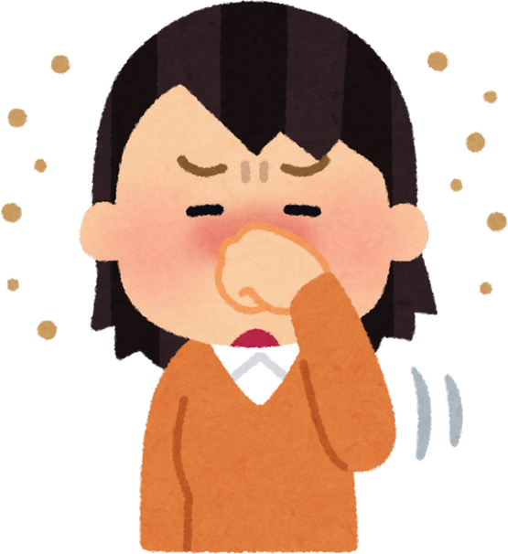






How are living things Affected by Air Pollution?
Polluted air can affect many living things. Because all of us breath the same air, pollution can make life harder for everyone. Can you think of other impacts?
We might cough more or feel tired. Our eyes may feel irritated or scratchy.
Animals might get sick or move away.
Plants may not grow as well if the air is dirty.

Slide 7
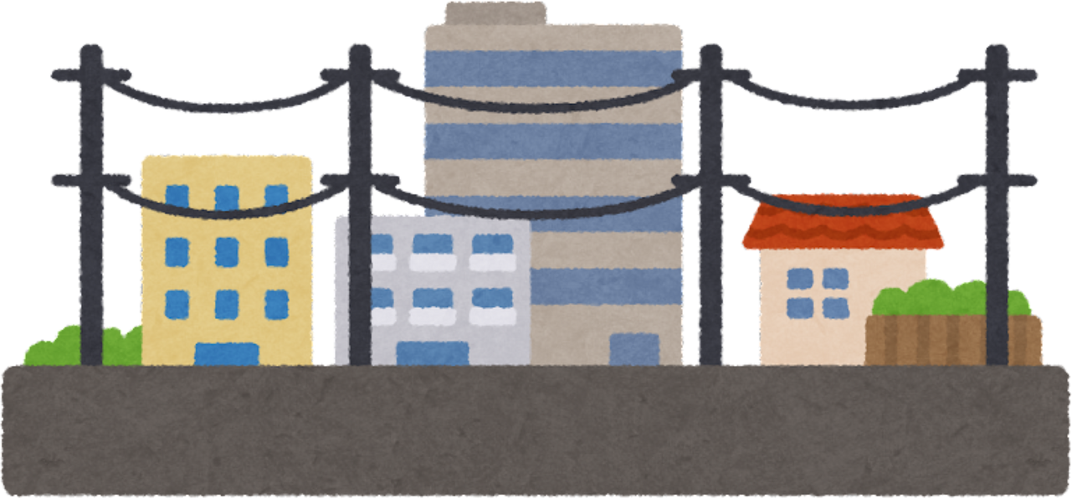
What does Air Pollution look like?
Sometimes we can see air pollution, like when smoke rises from a chimney or when the sky looks dusty or gray. What are some types of air pollution that you can see?
What can we do to measure pollution that we can’t see?

Slide 8
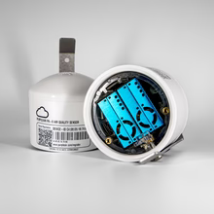
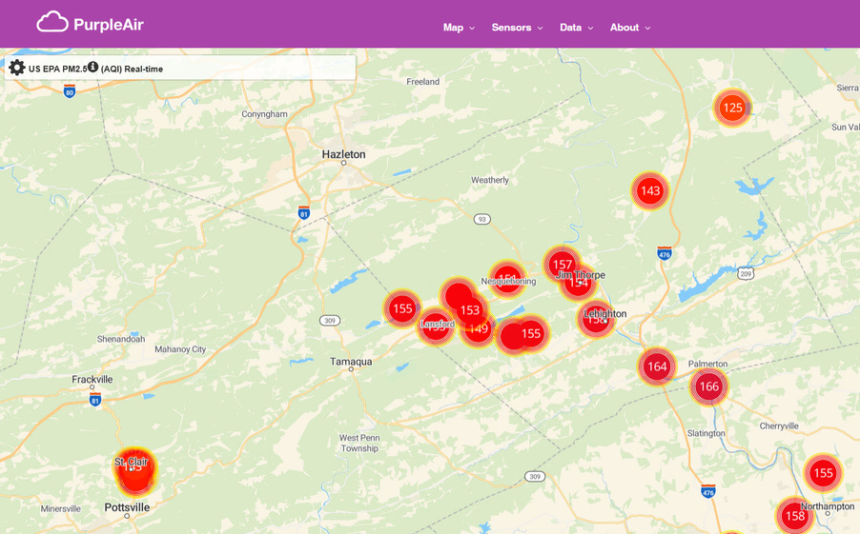
Save Carbon County Air quality monitoring
Because we can’t SEE every type of air pollution, Save Carbon County purchased and installed 15 PurpleAir Quality Monitors throughout Carbon County. You can see the status of our air anytime by going to www.purpleair.com and selecting Maps → Real-time Map
Here’s a picture of the Purple Air air quality Real-time Map during the recent Canadian wildfires. Smoke from far away can impact the air we breathe right here in Carbon County.

Slide 9




What Can Kids Do to Help?
Even kids can be heroes for the Earth! You might think you’re small, but your actions make a big difference.
What are some things you can do:
  Ride a bike or walk when you can
  Help plant trees
  Remind adults not to burn trash, plastic, or tires
Every little action helps the air stay clean!

Slide 10



Why Clean Air Helps the Earth
When the air is clean, everything feels better. Clean air also helps stop too much heat from staying around the Earth. By keeping the air clean, we are helping the whole planet stay happy and healthy for a long, long time.
People can breathe easily
birds can fly high
trees can grow tall and strong

Slide 11

Fun Fact!
Did you know that trees are like air cleaners?
They take in bad gases and give us clean oxygen to breathe!
So, the more trees we plant and care for, the cleaner our air will be.
Trees are our green friends — let’s protect them!

Slide 12
Thank You
Check for air pollution at
https://map.purpleair.com
Visit our webpage at
https://www.savecarboncounty.com/

Slide 13
Save Carbon County
Advocacy
Save Carbon County builds public support for our environmental advocacy through public and media engagement.
In 2018, our efforts were key to stopping the Penn East Pipeline which threatened dozens of watersheds along the Lehigh River and 31 high value streams in New Jersey.
In 2024, we successfully prevented zoning redesignations for a housing development that threatened Mauk Chunk Lake and the Jim Thorpe water supply.

Slide 14
Save Carbon County Air Quality Program
Part of the solution to establishing healthy communities is to monitor our air quality; other approaches include supporting science-based conservation efforts, community education, and activism.
In 2024, Panther Creek Power sought a PA-DEP permit to burn tire-derived fuels (TDF) in its Nesquehoning power plant. TDF incineration produces invisible, odorless cancer-causing gases like xylene, ethylene, benzene, acetone, and dioxin. Neither Panther Creek Power nor the PA Department of Environmental Protection (PA-DEP) monitors or regulates the emission of these known toxins.
So that we can understand what’s happening to our air quality, Save Carbon County initiated a program to monitor emissions from the Panther Creek Power Plant in Nesquehoning.

